Slide 1
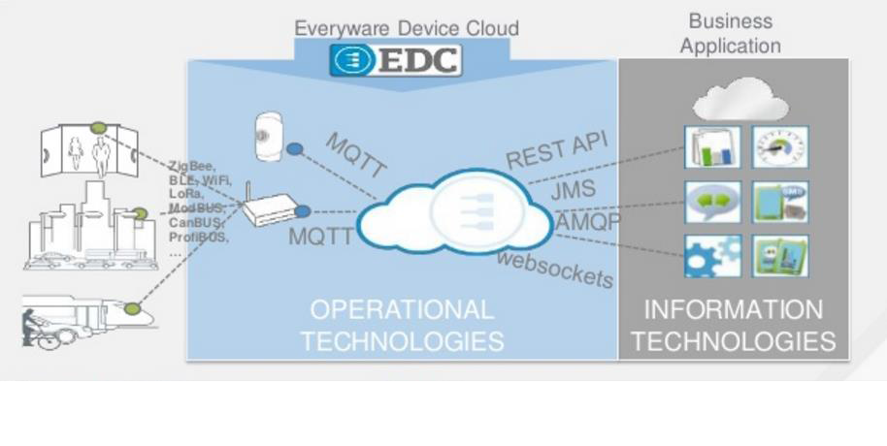
ACME Automobile IoT

Slide 2
Introduction
Overall Structure
Abstract Sensor Interface (Middleware)
Operational Technologies (IoT cloud)
Information Technologies (Business Application)

Slide 4
Abstract Sensor Interface
Sensors used
Global Sensor Networks (GSN)
Octopus
Sensing Layer
Aggregation Layer
Analysis Layer
World Model Layer (Internet & DBs)
Application Layer

Slide 5
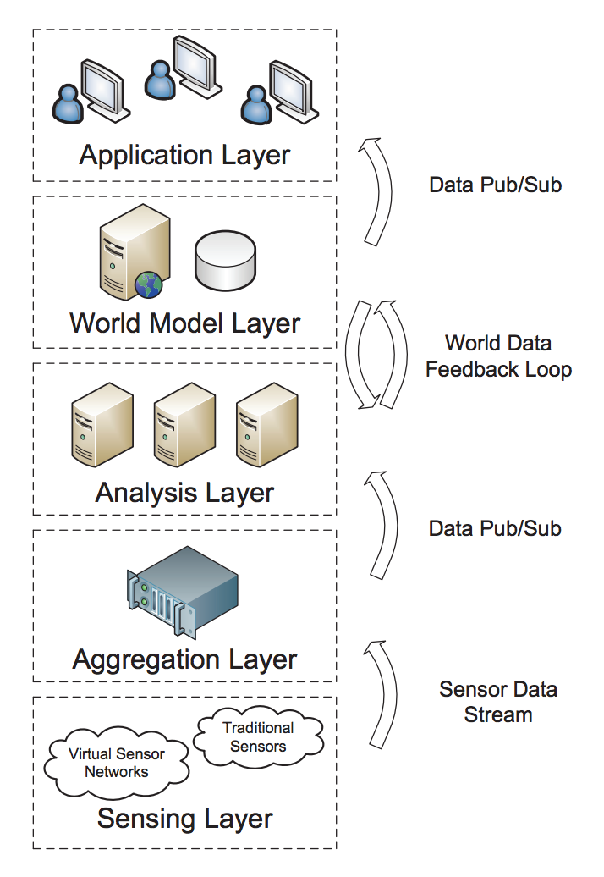
Notes:
Explain the layers
Sensing layer: layer where the system aggregates the data coming from different sensors
Aggregation layer: similar to the aggregation layer but it also includes information coming from different types of hardware. This layer creates a publisher subscriber relationship with the modules in the analysis level.
Analysis level: it has different modules called solvers that analyze the data at varying degrees of granularity. This is the layer that creates measures.
World Model Layer: this layer creates a hierarchy with the data and provides an API that allows application developers get the data without worrying where it is coming from. All they need to know is whether or not they are connecting to the appropriate module using the World Model Layer API.
Application layer: this layer could be any application. In our system it could be the raising and lowering the volume based on ambient noise and or the avoid a collision application.

Slide 6
Why this model?
Organized
Data separated from application
Different degrees of abstraction
Help widespread IoT development
No special training, just API
Notes:
Why we chose octopus to incorporate into our project
Octopus gives us a simple way of separating the data from the actual application development
The lower levels abstract the data without stopping
These lower levels can add new types of sensors or retire them without the rest of the system being affected.
The world model layer makes it easy for developers to connect to the sensors through the API, so they do not need to know exactly what happens behind the scenes.
This helps with adoption of IoT devices.

Slide 7
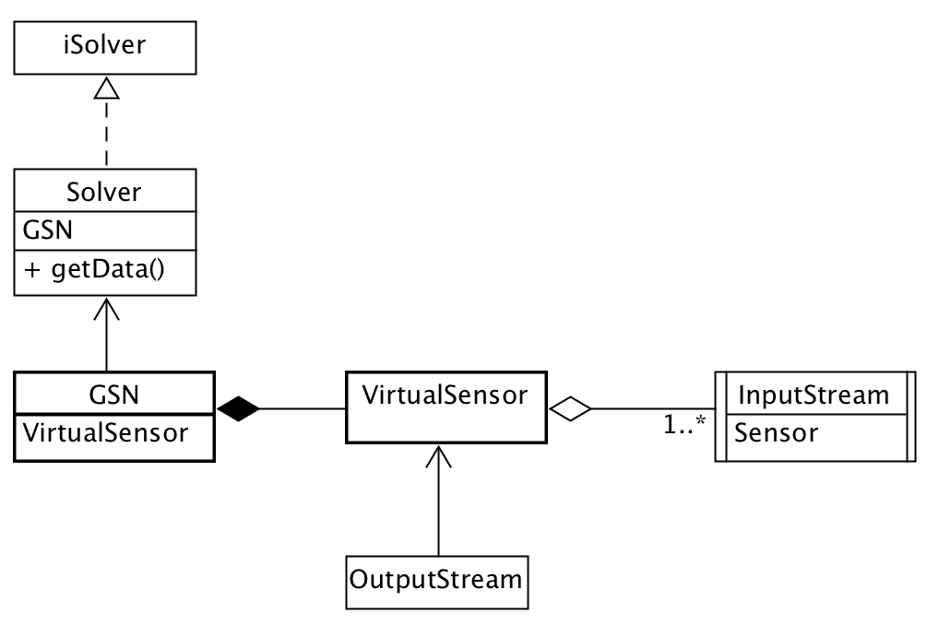
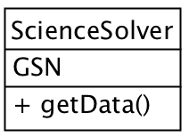
Information Technologies (Business Application)
How is it applied in our model?
1..*
Notes:
Virtual sensors within the GSN would wrap data coming from all different kinds of sensors to pass on to the GSN. In the diagram above we see how our sensor interface is one of the input streams to the VirtualSensor class. Virtual sensors can take one or many input streams but have only one output stream.
Subsequently, the data is passed to a Solver class. Solvers are part of the analysis layer. A solver is modular meaning that it has a particular implementation to deal with a specific kind of virtual sensor and the type of data this sensor provides. Below is an example of how concrete classes of the iSolver interface would look.

Slide 8
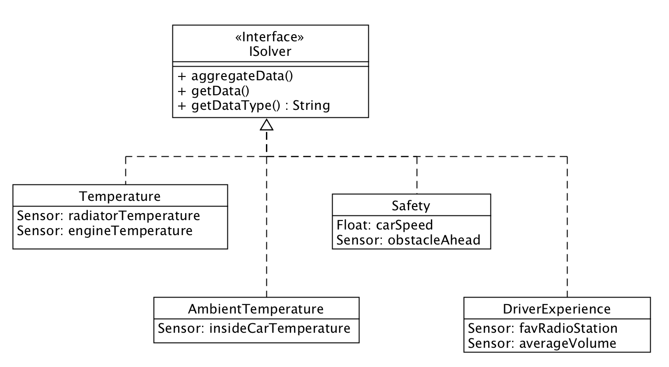
Example
How is it applied in our model
Notes:
Example of how modules apply to our model
First the different data sensors will be clustered into the solvers

Slide 9
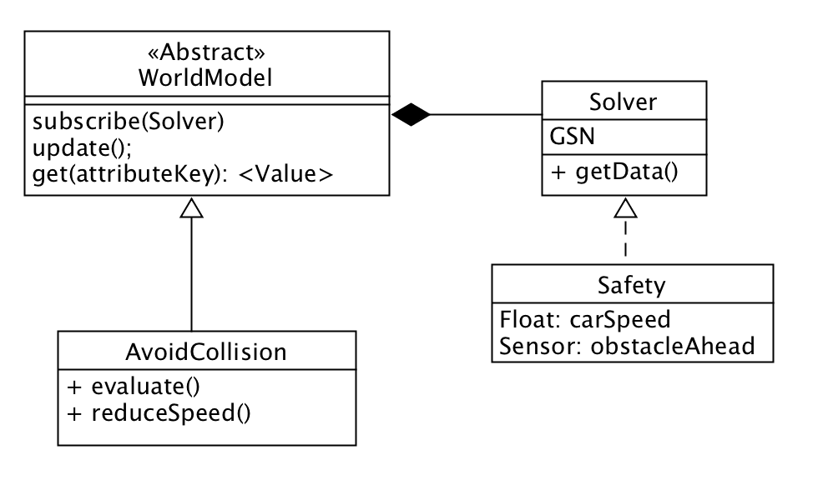
Example
1..*
Notes:
Then the solvers will connect to the World Model. Through the API, app developers can subscribe to the different models they want.
This is how it all comes together.

Slide 10


Thanks!

